Slide 1
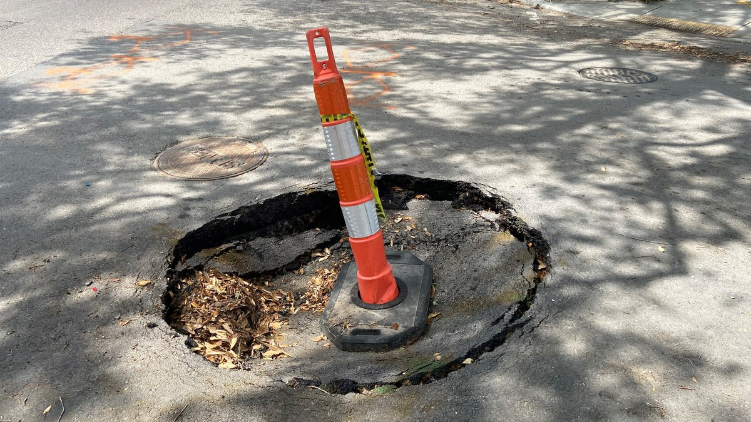
27
Road Roughness Mapping
Alan Pisano
Road Roughness Mapping
Team 27
Luke Bacopoulos, Aymane El Jerari, Balaji Sathyanarayanan, Jason Wang, Haoming Yi

Slide 2
27
Road Roughness Mapping
Alan Pisano
Problem Statement
-Rough road damages cause US drivers $26.5 billion per year and also leads to fatal accidents
-City of Boston uses a reporting system for locating potholes and road roughness
-City visually inspects road conditions once every three years
-A more streamlined system would make locating potholes more efficient, allowing for quicker road repairs and less money spent on average by drivers

Slide 3
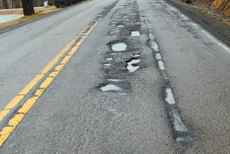

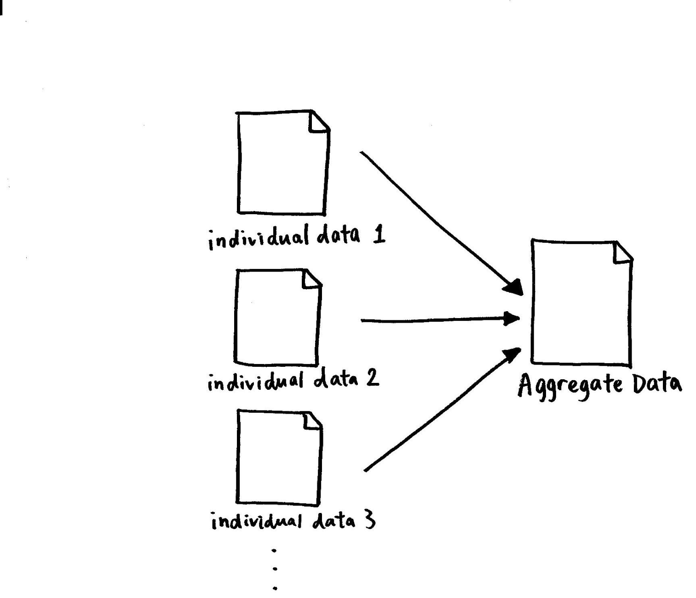
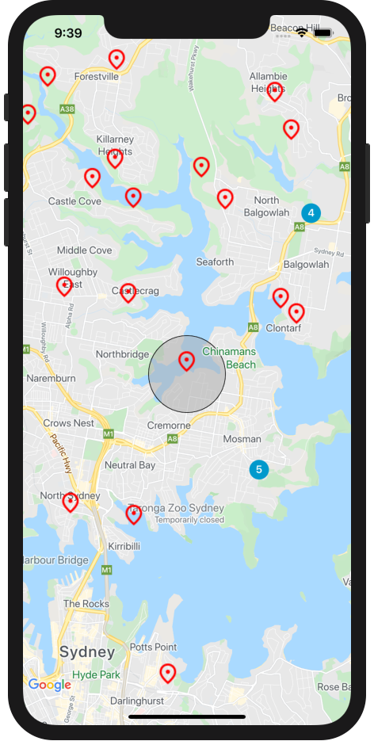
27
Road Roughness Mapping
Alan Pisano
Visualization
Algorithm decides the grade of roughness.
User places smartphone in dashboard mount.
Smartphone accelerometer measures road roughness.
Rough road locations are presented for users to view.
Aggregated data is uploaded and displayed on iOS app.
Rough road locations are uploaded and aggregated in order to protect user privacy.

Slide 4
27
Road Roughness Mapping
Alan Pisano
Deliverables
Mobile app
Upload image and location data to cloud
Display all detected potholes on a map
Speech Recognition
Allow the user to interact with the app using their voice
Convolutional Neural Network or Vision Transformer
Pothole binary image classifier
User privacy features
Allow user to draw perimeter where data collection is allowed

Slide 5
27
Road Roughness Mapping
Alan Pisano
Requirements
Functions
Record road roughness data (Accelerometer, Gyroscope)
Record location data (GPS, Wi-Fi)
Process recorded data (ESP-IDF, Raspberry Pi, Smartphone)
Store processed data (Micro SD Card, Cloud)
Transmit stored data (Wi-Fi, Bluetooth)
Objectives
Data Collection
Road roughness & location (mentioned above)
Data Analysis
Take into account the difference between cars
i.e. effect of suspension on data
Process the data with Machine Learning

Slide 6
27
Road Roughness Mapping
Alan Pisano
Requirements (cont’d)
Objectives (cont’d)
Data Presentation
Overlay the data on map to provide better driving experience
Present visualized data to the city for road improvements
Constraints
Self-contained device
Embedded battery instead of external connection
Privacy concerns
Anonymized data collection process
Full control given to user (when to start and end collection)
Consent from users

Slide 7
27
Road Roughness Mapping
Alan Pisano
Competing Technologies / Patents / Other Products
Pothole Detection Patent - A system that collects sensor data, determines potential potholes using a local processor, calculates the likelihood of actual potholes, displays them on map
Zang K, Shen J, Huang H, Wan M, Shi J. Assessing and Mapping of Road Surface Roughness based on GPS and Accelerometer Sensors on Bicycle-Mounted Smartphones. Sensors. 2018; 18(3):914. https://doi.org/10.3390/s18030914
Pothole Detector App (Project by Aniruddha Mysore)- detects potholes using the phone’s accelerometer/gyroscope, locates potholes on a map and uploads data to the cloud
Smart Pothole Detection System (Prof. Rohan Borgalli) - outputs the severity/diameter of potholes using a deep learning framework, leverages GPS, ultrasonic sensors, Pi-camera to collect data

